Slide 1
OR Mapping Code Library
Overview

Slide 2
Contents
Concept
Design
Implement OR mapping classes
Code Generator
Business Entity Operations
Modeling Business Entity Hierarchy
Extra Features
Advantages (why use this library)
More Uses

Slide 3
Concept
Very similar to current Corporate Business Object Lib
Find a easy and consistent way to do Business Object ←→ Database operation
Reading
Updating
Inserting
Deleting

Slide 4
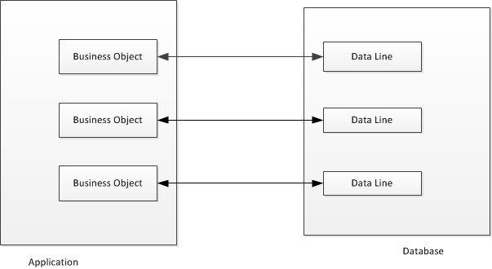
Business Object – Data Line Interaction
Concept

Slide 5
Business Object – Data Line Interaction
Concept
Business Objects
In memory objects – disappears when application exit
Help presenting object data
Help organize business logic
Database lines
Persistent data

Slide 6
Design
3 core classes
Business Entity Class
Business Rule Class
Business Data Access Class
Any Business object which mapping to data base table/view should provide these 3 classes
For read-only Business Entity (no database insert/update operation): Business Rule class is optional

Slide 7
Design
Business Entity
Business Rule
Business Data Access
Oracle Interface
Business Data Access Oracle Package
Business Data Table/View

Slide 8
Design
Business Entity Class
Is the in memory representation of the data lines
Class fields are equivalents to data columns
Field vs. Property
A Field is a Property with ColumnMapping attribute

Slide 9
Design
Business Rule Class
Specify Business Rules in this class
Business Data Access Class
Specify the insert, update, delete, select database command for its business entity
Specify the mapping between Business Entity properties/fields and database command parameters

Slide 10
Implement OR mapping classes
Implement Business Entity
Implement Business Rule
Implement Business Data Access
Implement Oracle Packages

Slide 11
Implement Business Entity
Implement OR mapping classes
Implement Business Entity
Implement abstract functions:
Public Class BdgtEntityEntity
Inherits BusinessEntity
Protected Overrides Function CreateDataAccess() As IBusinessDataAccess
Return New BdgtEntityDataAccess(Me)
End Function
Protected Overrides Function CreateBusinessRules() As IBusinessRules
Return New BdgtEntityRule(Me)
End Function

Slide 12
Implement OR mapping classes
Implement Business Entity
Declare data fields with ColumnMapping Attribute:
' Property VersionId
<ColumnMapping("VERSION_ID")> _
Public Property VersionId As Nullable(Of Decimal)
Get
Return CType(GetField("VersionId"), Nullable(Of Decimal))
End Get
Set(ByVal value As Nullable(Of Decimal))
SetField("VersionId", value)
End Set
End Property
' Property EntityId
<ColumnMapping("ENTITY_ID")> _
Public Property EntityId As Nullable(Of Decimal)
Get
Return CType(GetField("EntityId"), Nullable(Of Decimal))
End Get
Set(ByVal value As Nullable(Of Decimal))
SetField("EntityId", value)
End Set
End Property

Slide 13
Implement OR mapping classes
Implement Business Entity
Declare data fields with ColumnMapping Attribute:
' Property FdCutoffItemTxt5
<ColumnMapping("FD_CUTOFF_ITEM_TXT5")> _
Public Property FdCutoffItemTxt5 As String
Get
Return CType(GetField("FdCutoffItemTxt5"), String)
End Get
Set(ByVal value As String)
SetField("FdCutoffItemTxt5", value)
End Set
End Property
' Property FdCutoffItemVal2
<ColumnMapping("FD_CUTOFF_ITEM_VAL2")> _
Public Property FdCutoffItemVal2 As Nullable(Of Decimal)
Get
Return CType(GetField("FdCutoffItemVal2"), Nullable(Of Decimal))
End Get
Set(ByVal value As Nullable(Of Decimal))
SetField("FdCutoffItemVal2", value)
End Set
End Property
End Class

Slide 14
Implement Business Rule
Implement OR mapping classes
Override CheckBusinessRules function:
Public Class BdgtEntityRule
Inherits BusinessRule
Public Sub New(entity As BdgtEntityEntity)
MyBase.New(entity)
End Sub
Public Overrides Function CheckBusinessRules() As Boolean
Dim currentEntity As BdgtEntityEntity = CType(_businessEntity, BdgtEntityEntity)
If currentEntity IsNot Nothing Then
CheckEntityLevelChange(currentEntity)
CheckEntityIncludeChange(currentEntity)
FdCutoffItemTxt5Length(currentEntity)
End If
Return Me.ErrorCount = 0
End Function

Slide 15
Implement Business Rule
Implement OR mapping classes
Implement business rule check functions as needed:
Private Sub CheckEntityLevelChange(currentEntity As BdgtEntityEntity)
If currentEntity.EntityLevel = "OTH" Then
……...
If Query.HasQueryResult(command1) OrElse Query.HasQueryResult(command2) Then
AddError("EntityLevel", "cannot change to Other capital type. Exp/Dev Capital, Production or Reserves found on this entity.")
End If
ElseIf currentEntity.EntityLevel = "EXP" then
…
End If
End Sub

Slide 16
Implement Business Data Access
Implement OR mapping classes
Implement abstract functions:
Public Class BdgtEntityDataAccess
Inherits BusinessDataAccess
Public Sub New(ByVal entity As BdgtEntityEntity)
MyBase.New(entity)
End Sub
Public Overrides Function CreateEntitiesList() As IBindingList
Return New BusinessBindingList(Of BdgtEntityEntity)
End Function
Public Overrides Function CreateEntity() As IBusinessEntity
Return New BdgtEntityEntity()
End Function
Public Overloads ReadOnly Property BusinessEntity As BdgtEntityEntity
Get
Return MyBase.BusinessEntity
End Get
End Property
Public Overrides Function GetDBConfig() As IDBConfig
Return BudgetDBConfig.CurrentDBconfig
End Function

Slide 17
Implement Select functions :
Implement Select/SelectByPK/SelectByID as needed
Public Overrides Function CreateSelectCommand() As System.Data.IDbCommand
Dim oCommand As IDbCommand = Me.CreateCommand("DA_BdgtEntity.BdgtEntity_RA")
' Add Parameters
oCommand.Parameters.Add(CreateParameter("i_version_id", System.Data.OracleClient.OracleType.Number))
oCommand.Parameters.Add(CreateParameter("cur_out", System.Data.OracleClient.OracleType.Cursor, System.Data.ParameterDirection.Output))
' Map Parameters
SetParameterValue(oCommand, "i_version_id", GetField("VersionId"))
Return oCommand
End Function
Public Overrides Function CreateSelectByPkCommand() As System.Data.IDbCommand
Dim oCommand As System.Data.OracleClient.OracleCommand = Me.CreateCommand("DA_BdgtEntity.BdgtEntity_R_PK")
' Add Parameters
oCommand.Parameters.Add(CreateParameter("i_version_id", System.Data.OracleClient.OracleType.Number))
oCommand.Parameters.Add(CreateParameter("i_entity_id", System.Data.OracleClient.OracleType.Number))
oCommand.Parameters.Add(CreateParameter("cur_out", System.Data.OracleClient.OracleType.Cursor, System.Data.ParameterDirection.Output))
' Map Parameters
SetParameterValue(oCommand, "i_version_id", BusinessEntity.VersionId)
SetParameterValue(oCommand, "i_entity_id", BusinessEntity.EntityId)
Return oCommand
End Function

Slide 18
Implement Business Data Access
Implement OR mapping classes
Implement Insert functions:
(If you wish to create new data line)
Public Overrides Function CreateInsertCommand() As System.Data.IDbCommand
Dim oCommand As System.Data.OracleClient.OracleCommand = Me.CreateCommand("DA_BdgtEntity.BdgtEntity_C")
' Add Parameters
oCommand.Parameters.Add(CreateParameter("i_fd_cutoff_item_txt5", System.Data.OracleClient.OracleType.VarChar))
oCommand.Parameters.Add(CreateParameter("i_fd_cutoff_item_val2", System.Data.OracleClient.OracleType.Number))
oCommand.Parameters.Add(CreateParameter("i_fd_cutoff_item_val3", System.Data.OracleClient.OracleType.Number))
……..
' Map Parameters
SetParameterValue(oCommand, "i_version_int_id", BusinessEntity.VersionIntId))
SetParameterValue(oCommand, "i_entity_int_id", BusinessEntity.EntityIntId))
SetParameterValue(oCommand, "i_fd_cutoff_item_txt5", GetField("FdCutoffItemTxt5"))
SetParameterValue(oCommand, "i_fd_cutoff_item_val2", GetField("FdCutoffItemVal2"))
SetParameterValue(oCommand, "i_fd_cutoff_item_val3", GetField("FdCutoffItemVal3"))
……….
Return oCommand
End Function

Slide 19
Implement Business Data Access
Implement OR mapping classes
Implement Update functions:
(if you wish to update data)
Public Overrides Function CreateUpdateCommand() As System.Data.IDbCommand
Dim oCommand As System.Data.OracleClient.OracleCommand = Me.CreateCommand("DA_BdgtEntity.BdgtEntity_U")
' Add Parameters
oCommand.Parameters.Add(CreateParameter("i_fd_cutoff_item_txt5", System.Data.OracleClient.OracleType.VarChar))
oCommand.Parameters.Add(CreateParameter("i_fd_cutoff_item_val2", System.Data.OracleClient.OracleType.Number))
oCommand.Parameters.Add(CreateParameter("i_fd_cutoff_item_val3", System.Data.OracleClient.OracleType.Number))
oCommand.Parameters.Add(CreateParameter("i_version_int_id", System.Data.OracleClient.OracleType.Number))
oCommand.Parameters.Add(CreateParameter("i_entity_int_id", System.Data.OracleClient.OracleType.Number))
………
' Map Parameters
SetParameterValue(oCommand, "i_fd_cutoff_item_txt5", GetField("FdCutoffItemTxt5"))
SetParameterValue(oCommand, "i_fd_cutoff_item_val2", BusinessEntity.FdCutoffItemVal2))
SetParameterValue(oCommand, "i_fd_cutoff_item_val3", BusinessEntity.FdCutoffItemVal3)
SetParameterValue(oCommand, "i_version_id", GetField("VersionId"))
SetParameterValue(oCommand, "i_entity_id", GetField("EntityId"))
…….
Return oCommand
End Function

Slide 20
Implement Business Data Access
Implement OR mapping classes
Implement Delete functions:
(if delete data line is needed)
Public Overrides Function CreateDeleteCommand() As System.Data.IDbCommand
Dim oCommand As System.Data.OracleClient.OracleCommand = Me.CreateCommand("DA_BdgtEntity.BdgtEntity_D")
' Add Parameters
oCommand.Parameters.Add(CreateParameter("i_version_id", System.Data.OracleClient.OracleType.Number))
oCommand.Parameters.Add(CreateParameter("i_entity_id", System.Data.OracleClient.OracleType.Number))
' Map Parameters
SetParameterValue(oCommand, "i_version_id", BusinessEntity.VersionId))
SetParameterValue(oCommand, "i_entity_id", BusinessEntity.EntityId))
Return oCommand
End Function

Slide 21
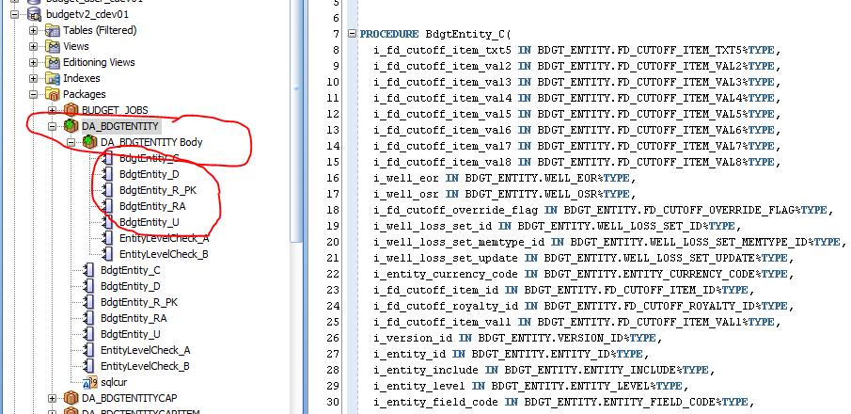
Implement Oracle Packages
Implement OR mapping classes

Slide 22
Implement Oracle Packages
Implement OR mapping classes
PROCEDURE BdgtEntity_RA(
i_version_id IN BDGT_ENTITY.VERSION_ID%TYPE,
cur_out OUT DA_BdgtEntity.sqlcur) IS
BEGIN
OPEN cur_out FOR
SELECT FD_CUTOFF_ITEM_TXT5,FD_CUTOFF_ITEM_VAL2,FD_CUTOFF_ITEM_VAL3,FD_CUTOFF_ITEM_VAL4,FD_CUTOFF_ITEM_VAL5,FD_CUTOFF_ITEM_VAL6,FD_CUTOFF_ITEM_VAL7,FD_CUTOFF_ITEM_VAL8,WELL_EOR,WELL_OSR,FD_CUTOFF_OVERRIDE_FLAG,WELL_LOSS_SET_ID…, CHANGE_DATE
FROM BDGT_ENTITY
where version_id = i_version_id;
END;
PROCEDURE BdgtEntity_R_PK(
i_version_id IN BDGT_ENTITY.VERSION_ID%TYPE,
i_entity_id IN BDGT_ENTITY.ENTITY_ID%TYPE,
cur_out OUT DA_BdgtEntity.sqlcur) Is
BEGIN
OPEN cur_out FOR
SELECT FD_CUTOFF_ITEM_TXT5,FD_CUTOFF_ITEM_VAL2,FD_CUTOFF_ITEM_VAL3,FD_CUTOFF_ITEM_VAL4,FD_CUTOFF_ITEM_VAL5,FD_CUTOFF_ITEM_VAL6,FD_CUTOFF_ITEM_VAL7,FD_CUTOFF_ITEM_VAL8,WELL_EOR,WELL_OSR,FD_CUTOFF_OVERRIDE_FLAG,WELL_LOSS_SET_ID,…,CHANGE_BY, CHANGE_DATE
FROM BDGT_ENTITY
where version_id = i_version_id and entity_id = i_entity_id;
END;
PROCEDURE BdgtEntity_U(
i_fd_cutoff_item_txt5 IN BDGT_ENTITY.FD_CUTOFF_ITEM_TXT5%TYPE,
i_fd_cutoff_item_val2 IN BDGT_ENTITY.FD_CUTOFF_ITEM_VAL2%TYPE,
i_fd_cutoff_item_val3 IN BDGT_ENTITY.FD_CUTOFF_ITEM_VAL3%TYPE,
i_fd_cutoff_item_val4 IN BDGT_ENTITY.FD_CUTOFF_ITEM_VAL4%TYPE, …..

Slide 23
Implement Oracle Packages
Implement OR mapping classes
PROCEDURE BdgtEntity_RA(
i_version_id IN BDGT_ENTITY.VERSION_ID%TYPE,
cur_out OUT DA_BdgtEntity.sqlcur) IS
BEGIN
OPEN cur_out FOR
SELECT FD_CUTOFF_ITEM_TXT5,……
FROM BDGT_ENTITY
where version_id = i_version_id;
END;
PROCEDURE BdgtEntity_R_PK(
i_version_id IN BDGT_ENTITY.VERSION_ID%TYPE,
i_entity_id IN BDGT_ENTITY.ENTITY_ID%TYPE,
cur_out OUT DA_BdgtEntity.sqlcur) Is
BEGIN
OPEN cur_out FOR
SELECT FD_CUTOFF_ITEM_TXT5,FD_CUTOFF_ITEM_VAL2,……
FROM BDGT_ENTITY
where version_id = i_version_id and entity_id = i_entity_id;
END;
PROCEDURE BdgtEntity_U(
i_fd_cutoff_item_txt5 IN BDGT_ENTITY.FD_CUTOFF_ITEM_TXT5%TYPE,
i_fd_cutoff_item_val2 IN BDGT_ENTITY.FD_CUTOFF_ITEM_VAL2%TYPE,
i_fd_cutoff_item_val3 IN BDGT_ENTITY.FD_CUTOFF_ITEM_VAL3%TYPE,
i_fd_cutoff_item_val4 IN BDGT_ENTITY.FD_CUTOFF_ITEM_VAL4%TYPE, …..
Public Overrides Function CreateSelectCommand() As System.Data.IDbCommand
Dim oCommand As IDbCommand = Me.CreateCommand("DA_BdgtEntity.BdgtEntity_RA")
' Add Parameters
oCommand.Parameters.Add(CreateParameter("i_version_id", System.Data.OracleClient.OracleType.Number))
' Map Parameters
SetParameterValue(oCommand, "i_version_id", GetField("VersionId"))
Return oCommand
End Function
Public Overrides Function CreateSelectByPkCommand() As System.Data.IDbCommand
Dim oCommand As System.Data.OracleClient.OracleCommand = Me.CreateCommand("DA_BdgtEntity.BdgtEntity_R_PK")
' Add Parameters
oCommand.Parameters.Add(CreateParameter("i_version_id", System.Data.OracleClient.OracleType.Number))
oCommand.Parameters.Add(CreateParameter("i_entity_id",
' Map Parameters
SetParameterValue(oCommand, "i_version_id", BusinessEntity.VersionId)
Return oCommand
End Function

Slide 24
Code Generator
Too much coding?
Yes, we have code generator
It is based on the current Business Object Lib’s Code Generator
Generate 4 files:
Business Entity code
Business Rule code
Business Data Access code
Oracle Package SQL file
Code Generator at TFS: $/Exploitation/APPLICATIONS/Tools/ORMappingEntityGenerator

Slide 25
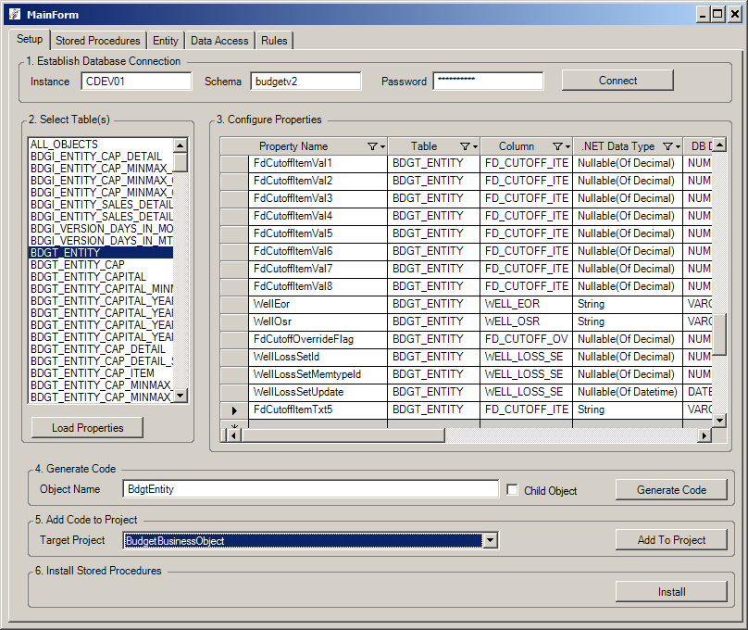
Code Generator

Slide 26
Business Entity Operation:
Load
Save
Delete
Create/New

Slide 27
Business Entity Operation:
Business Entity Load:
Single Entity:
LoadMeByPK() : --> call SelectByPK command in DataAccess class
Refresh() : same as LoadMeByPK()
LoadMeById() : → call SelectById command command in DataAccess class
Load first one if multiple entities found
Dim _bdgtEntity As New BdgtEntityEntity
_bdgtEntity.VersionId = 2
_bdgtEntity.EntityId = 221
_bdgtEntity.Refresh()

Slide 28
Business Entity Operation:
Business Entity Load:
Entity List:
LoadEntities : → call Select Command command in DataAccess class
LoadEntitiesById : → call SelectById command command in DataAccess class
LoadEntities(command As System.Data.IDbCommand)
pass in a command
LoadEntities(sql as string )
pass in a sql (select statement)
Dim _bdgtEntityWellLossDtList As New BusinessBindingList(Of BdgtEntityWellLossDtEntity)
Dim bdgtEntityWellLossDt As New BdgtEntityWellLossDtEntity
bdgtEntityWellLossDt.VersionId = 2
bdgtEntityWellLossDt.EntityId = 221
bdgtEntityWellLossDt.LoadEntitiesById(_bdgtEntityWellLossDtList)
Dim list as BusinessBindingList(Of BdgtEntityWellLossDtEntity) = bdgtEntityWellLossDt.LoadEntities ()

Slide 29
Business Entity Operation:
Business Entity Save: → calls Update or Insert command in DataAccess Class
Single Entity:
Dim _bdgtEntity As New BdgtEntityEntity
_bdgtEntity.VersionId = 2
_bdgtEntity.EntityId = 221
_bdgtEntity.Refresh()
_bdgtEntity.EntityInclude = “Y”
_bdgtEntity.WellBhLocation = “3522fdb”
_bdgtEntity.Save()

Slide 30
Business Entity Operation:
Business Entity Delete: → Calls Delete command in DataAccess Class
Single Entity:
Dim _bdgtEntity As New BdgtEntityEntity
_bdgtEntity.VersionId = 2
_bdgtEntity.EntityId = 221
_bdgtEntity.Delete()

Slide 31
Business Entity Operation:
Business Entity Create/New:
Single Entity:
Dim secLog As New SecurityLogEntity
secLog.StaffId = SecurityUserEntity.CurrentUser.StaffId
secLog.LogAction = “Log In”
secLog.Save()

Slide 32
Business Entity Operation:
Business Entity List
Save and Delete
Dim _bdgtEntityWellLossDtList As New BusinessBindingList(Of BdgtEntityWellLossDtEntity)
Dim bdgtEntityWellLossDt As New BdgtEntityWellLossDtEntity
bdgtEntityWellLossDt.VersionId = 2
bdgtEntityWellLossDt.EntityId = 221
bdgtEntityWellLossDt.LoadEntitiesById(_bdgtEntityWellLossDtList)
‘updatding
_bdgtEntityWellLossDtList(0).Include = “Y”
_bdgtEntityWellLossDtList(1).Level = “DEV”
‘Save all changes of its entities
_bdgtEntityWellLossDtList.Save()
‘Delete all entities in the list and their child entities
_bdgtEntityWellLossDtList.Delete(true)
‘Delete one entity and its child entities
_bdgtEntityWellLossDtList.Delete(_bdgtEntityWellLossDtList(1), true)

Slide 33
Modeling Business Entity Hierarchy
Organize entities in Hierarchy
Root Place Hold
entity
Budget OnStream Entity
Budget Entity
Production Entity
Capital Entity
Capital Item Entity
Capital Plan Entity
List(of WellLossDtEntity)

Slide 34
Modeling Business Entity Hierarchy
Public Class BdgtEntityCapOnstreamEntity
Inherits AppEntityBase
Private _budgetRootPlaceHoldEntity As BudgetRootPlaceHoldEntity
Public ReadOnly Property BudgetRootPlaceHoldEntity As BudgetRootPlaceHoldEntity
Get
If _budgetRootPlaceHoldEntity Is Nothing Then
_budgetRootPlaceHoldEntity = New BudgetRootPlaceHoldEntity
End If
Return _budgetRootPlaceHoldEntity
End Get
End Property
Public Overrides Sub LoadChildEntities()
ClearChildEntities()
Dim rootEntity As BudgetRootPlaceHoldEntity = BudgetRootPlaceHoldEntity
'Add to child entity collection
AddChildEntity(rootEntity)
rootEntity.VersionId = Me.VersionId
rootEntity.EntityId = Me.EntityId
rootEntity.RefreshAll()
rootEntity.SetReadonly(IsLockDownCapStart)
End Sub
Public Overrides Sub UnLoadChildEntities()
ClearChildEntities()
If _budgetRootPlaceHoldEntity IsNot Nothing Then
_budgetRootPlaceHoldEntity = Nothing
End If
End Sub
Organize entities in Hierarchy
Override LoadChildEntities and UnLoadChildEntities

Slide 35
Modeling Business Entity Hierarchy
Organize entities in Hierarchy
Override LoadChildEntities and UnLoadChildEntities
Public Class BudgetRootPlaceHoldEntity
Inherits PlaceHoldEntity
private _bdgtEntity As New BdgtEntityEntity
Private _bdgtEntityWellLossDtList As New BusinessBindingList(Of BdgtEntityWellLossDtEntity)
Public Overrides Sub LoadChildEntities()
'call this to clear current child entity collection
ClearChildEntities()
_bdgtEntity.VersionId = Me.VersionId
_bdgtEntity.EntityId = Me.EntityId
_bdgtEntity.Refresh()
Dim bdgtEntityWellLossDt As New BdgtEntityWellLossDtEntity
bdgtEntityWellLossDt.VersionId = Me.VersionId
bdgtEntityWellLossDt.EntityId = Me.EntityId
bdgtEntityWellLossDt.LoadEntitiesById(_bdgtEntityWellLossDtList)
…….
'Add to child entity collection
AddChildEntity(_bdgtEntity)
…….
End Sub
Public Overrides Sub UnLoadChildEntities()
ClearChildEntities()
'Clear child entities to release memory
_bdgtEntity.Clear()
_bdgtEntityMetrics.Clear()
_bdgtEntityWellLossDtList.Clear()
_bdgtEntityWellLossTaList.Clear()
_bdgtEntityCap.ClearAll()
_prodPlaceHoldEntity.ClearAll()
End Sub

Slide 36
Extra Features
Calculation Property change automatic notification
Property Writable → UI Control Enable/Read-only data binding
Property Writable change based on Property Change
Business Entity → Data table multi-primary-keys support
Backup field(s) and Restore field(s)

Slide 37
Extra Features
Calculation Property change automatic notification
Business Entity class implements INotifyPropertyChanged
Interface. Hence data field change will be notified so that
any object (usually UI Control) bound to a data field
knows to update display when its value changed.
While Calculation Property is not an actually data field, so how
do UI Controls know when its value changed?

Slide 38
Extra Features
Calculation Property change automatic notification
Declare ParentProperty Attribute:
<ParentProperty({"CustomSortGroup2"})>
Public ReadOnly Property IsNVAWO()
Get
Return "NVAWO".Equals(Me.CustomSortGroup2)
End Get
End Property
<ParentPropertyAttribute({"IsLockDownCapStart", "CustomSortGroup2"})>
Public ReadOnly Property AllowDelete() As Boolean
Get
Dim allow As Boolean = False
If Not IsLockDownCapStart Then
If SecurityUserEntity.CurrentUser.HasFieldCodeAccess(EntityFieldCode) Then
If Not (IsNVAWO Or IsThermal) Then
allow = True
End If
End If
End If
Return allow
End Get
End Property

Slide 39
Extra Features
Property Writable → UI Control Enable/Read-only data binding
Enable/disable UI Control based on Property Is Writable or not
Set UI Control Readonly based on Property Is Writable or not
dim commentWritableBinder as PropertyWritableBinder = new PropertyWritableBinder("WellComments")
txtComments. DataBindings.Add( New Binding("ReadOnly", commentWritableBinder , "IsReadOnly"))
commentWritableBinder.BindTo(_budgetEntity)

Slide 40
Extra Features
Property Writable → UI Control Enable/Read-only data binding
Public Overrides Function CheckPropertyUiWritable(propertyName As String) As Boolean
If Not SecurityUserEntity.CurrentUser.HasFieldCodeAccess(EntityFieldCode) Then
Return False
End If
Dim writable As Boolean = False
Select Case propertyName
Case "WellSlDesc", "WellPlaytypeCode", "WellType", "WellOrient", "WellRigType", "WellTvd", "WellMd"
If "EXP".Equals(EntityLevel) Then
writable = True
End If
If IsNVAWO() Or IsThermal() Then
writable = False
End If
……
return writable

Slide 41
Extra Features
Property Writable change based on Property Change
Override GetUiWritableDependentProperties function
Protected Overrides Function GetUiWritableDependentProperties(propertyName As String) As String()
Select Case propertyName
'If EntityLevel changes, following Properties’ Writable attribute might change
Case "EntityLevel"
Return {"WellSlDesc", "WellPlaytypeCode", "WellType", "WellOrient", "WellRigType", "WellTvd", "WellMd",
"FdCutoffItemVal1", "FdCutoffItemVal3",
"FdCutoffItemVal2", "FdCutoffItemVal4"}
Case "CustomSortGroup2"
Return {"WellSlDesc", "WellPlaytypeCode", "WellType", "WellOrient", "WellRigType", "WellTvd", "WellMd",
"EntityInclude", "EntityLevel", "EntityFieldCode", "EntityCurrencyCode", "WellZoneDesc", "EntityBusiness", _
"FdCutoffItemTxt5", "FdCutoffItemId", "FdCutoffOverrideFlagCheckState"}
Case "FdCutoffOverrideFlagCheckState"
Return {"FdCutoffItemVal1", "FdCutoffItemVal3",
"FdCutoffItemVal2", "FdCutoffItemVal4"}
End Select
Return Nothing
End Function

Slide 42
Extra Features
Business Entity → Data table multi-primary-keys support
Public Class SecurityDelegateDataAccess
Inherits BusinessDataAccess
…………..
Public Overrides Function InsertCommandOutParamToPKMap() As String(,)
Return {{"O_STAFF_ID", "STAFF_ID"},
{"O_STAFF_DELEGATE_ID", "STAFF_DELEGATE_ID"}}
End Function
Public Overrides Function CreateInsertCommand() As System.Data.IDbCommand
Dim oCommand As System.Data.OracleClient.OracleCommand = Me.CreateCommand("DA_SECURITYDELEGATE.SECURITYDELEGATE_C")
' Add Parameters
oCommand.Parameters.Add(CreateParameter("i_staff_id", System.Data.OracleClient.OracleType.Number, ParameterDirection.InputOutput))
oCommand.Parameters.Add(CreateParameter("i_staff_delegate_id", System.Data.OracleClient.OracleType.Number, ParameterDirection.InputOutput))
oCommand.Parameters.Add(CreateParameter("i_override_lockdown_version_id", System.Data.OracleClient.OracleType.Number))
' Map Parameters
SetParameterValue(oCommand, "i_staff_id", BusinessEntity.StaffId)
SetParameterValue(oCommand, "i_staff_delegate_id", BusinessEntity.StaffDelegateId)
SetParameterValue(oCommand, "i_override_lockdown_version_id", BusinessEntity.OverrideLockdownVersionId)
Return oCommand
End Function

Slide 43
Extra Features
Business Entity → Data table multi-primary-keys support
PROCEDURE SECURITYDELEGATE_C(
i_staff_id IN OUT SECURITY_DELEGATE.STAFF_ID%TYPE,
i_staff_delegate_id IN OUT SECURITY_DELEGATE.STAFF_DELEGATE_ID%TYPE,
i_override_lockdown_version_id IN SECURITY_DELEGATE.OVERRIDE_LOCKDOWN_VERSION_ID%TYPE
)
IS
BEGIN
INSERT INTO SECURITY_DELEGATE
(
STAFF_ID,
STAFF_DELEGATE_ID,
OVERRIDE_LOCKDOWN_VERSION_ID)
VALUES
(
i_staff_id,
i_staff_delegate_id,
i_override_lockdown_version_id)
returning staff_id, STAFF_DELEGATE_ID into i_staff_id, i_staff_delegate_id;
END;

Slide 44
Extra Features
Backup field(s) and Restore field(s)
declineEntity.BackupFields()
_declineEntity.RestoreToBackupFields()
_declineEntity.ClearBackupField()
_declineEntity.BackupField(“Description”)
_declineEntity.GetBackupField(“Description”)
_declineEntity.RestoreToBackupField(“Description”)

Slide 45
Advantages (why use this library)
Small code base
We have all the source code (No third-party lib)
So
It is easy to learn and use
Don’t understand a function, just look into the source code

Slide 46
Entity Class
More Uses
Override OnSetField to check field change
Protected Overrides Sub OnSetField(fieldName As String, newFieldValue As Object, oldFieldValue As Object, fromDbLoading As Boolean)
If Not fromDbLoading Then
If Not Object.Equals(oldFieldValue, newFieldValue) Then
If fieldName = "WellPrimaryProdCode" Then
RaiseEvent LockDownChanged(Me)
RaiseEvent BudgetPrimaryProductChanged(Me)
ElseIf fieldName = "EntityCurrencyCode" Then
RaiseEvent BudgetCurrencyChanged(Me)
End If
End If
End If
End Sub

Slide 47
DBUtil Class
More Uses
ExecuteProcedure
If MsgBox("Confirm duplicate from version " & versionFromName & " (#" & versionFromId & ") to " & versionToName & " (#" & versionToId & ")", MsgBoxStyle.YesNo, "Confirm duplicate budget") = MsgBoxResult.Yes Then
Me.Cursor = Cursors.WaitCursor
Call New BudgetDBUtil().ExecuteProcedure("version_duplicate", {versionFromId, versionToId, versionToName})
Me.Cursor = Cursors.Arrow
MsgBox("Done duplicating from version " & versionFromName & " (#" & versionFromId & ") to " & versionToName & " (#" & versionToId & ")")
End If

Slide 48
DBUtil Class
More Uses
ExecuteCommand
Public Sub Calc2For1Numbers()
Call New DBUtil(BudgetDBConfig.CurrentDBconfig).ExecuteCommand("UPDATE " & BudgetDBConfig.CurrentDBconfig.DatabaseSchema & ".BDGT_ENTITY_METRICS SET risked_excess_2for1=0 WHERE version_id=" & VersionId & " AND entity_id=" & EntityId)
End Sub

Slide 49
Query Class
More Uses
HasResult
If New BudgetQuery().HasResult("SELECT * FROM " & BudgetDBConfig.CurrentDBconfig.DatabaseSchema & ".TPLT_CAPITAL_LINKREQD_V WHERE capital_version_id ='" & version.CapitalVersionAncestorId & "'") Then
MsgBox("Error! Unlinked records still exist. Can not apply Capital Template Numbers. Press 'Links' button to view.", MsgBoxStyle.OkOnly, "Can not apply Capital Template Numbers")
Return
End If

Slide 50
Query Class
More Uses
GetResultCount
If Not New BudgetQuery().GetResultCount("SELECT * FROM " BudgetDBConfig.CurrentDBconfig.DatabaseSchema & ".BDGT_ENTITY_CAP_ITEM WHERE VERSION_ID = " & currentEntity.VersionId & " And ENTITY_ID = " & currentEntity.EntityId) > 0 Then
AddError("EntityInclude", "Cannot include this entity in the budget. Missing Capital")
End If

